Slide 1
Next2Call Telephony Panel Overview
Feature Screens & Admin Panel Highlights

Slide 2
About, Next2Call.com
Next2Call.com offers cloud-based telephony software with inbuilt CRM, global VoIP solutions, and real-time analytics for call center operations. The platform enables efficient lead management, user-friendly call reporting, and high availability through advanced call routing.

Slide 3
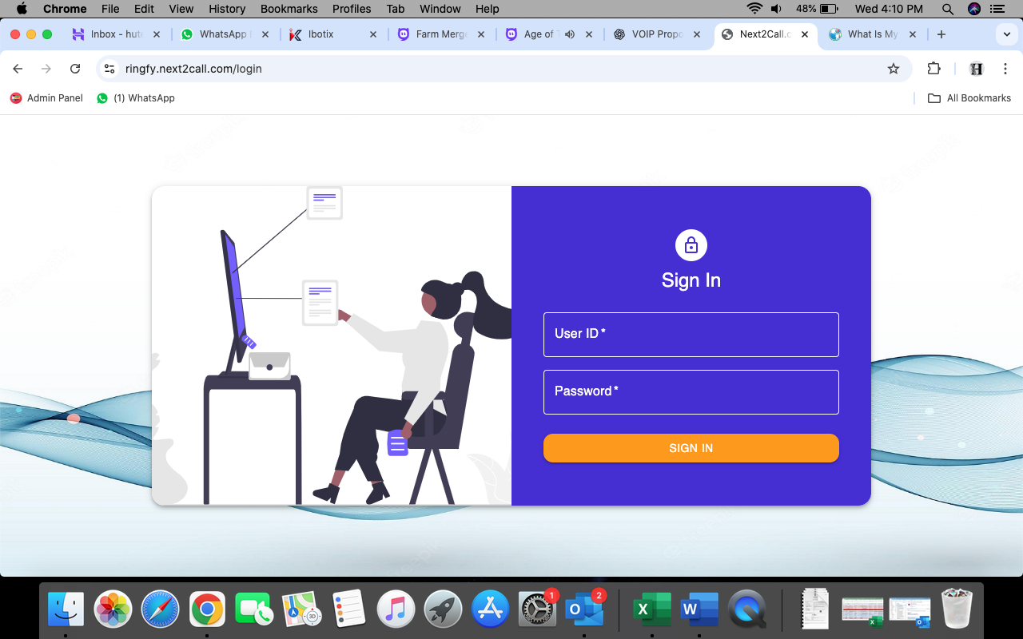
Login Page
The secure OTP Based login page allows admin and agents to access the telephony panel with role-based access control.

Slide 4
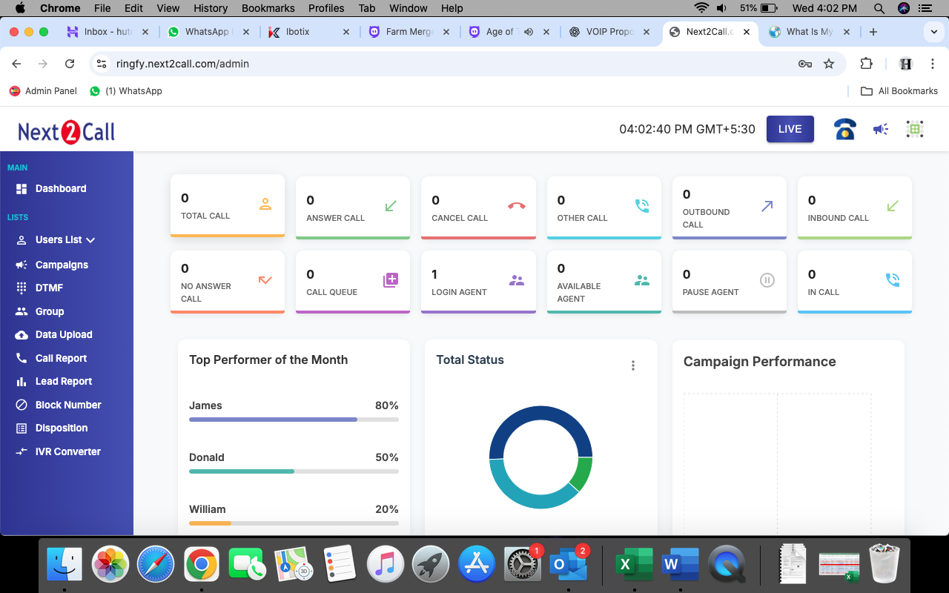
Dashboard
-Shows live campaign status
-Agent availability
-Live call monitoring
-Real-time summary of connected calls

Slide 5
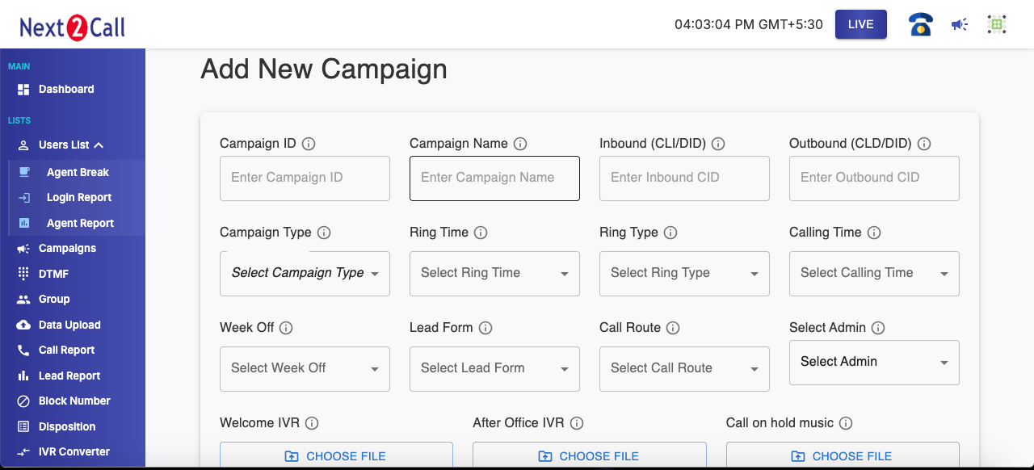
Add/Create Campaign

Slide 6
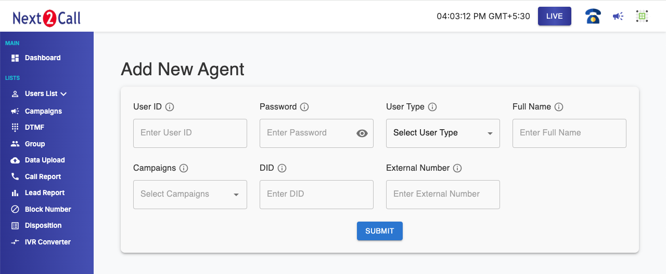
Add User / Agent
Admin can add agents with details like name, username, password
Assign them to campaigns and queues
Enable/disable users with a click

Slide 7
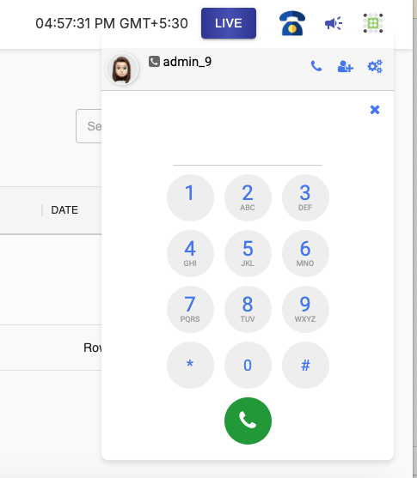
Inbuilt Softphone
Call Transfer (Blind & Attended)
Easily transfer calls to another agent or department with a single click.
Call Conference Add multiple participants into a live call for instant team collaboration or client consultations.
Call Barging & Whispering Supervisors can monitor calls silently or assist agents in real-time without the customer hearing.
Secure & Browser-Based Works over HTTPS and WebRTC, ensuring secure, plugin-free connectivity.

Slide 8
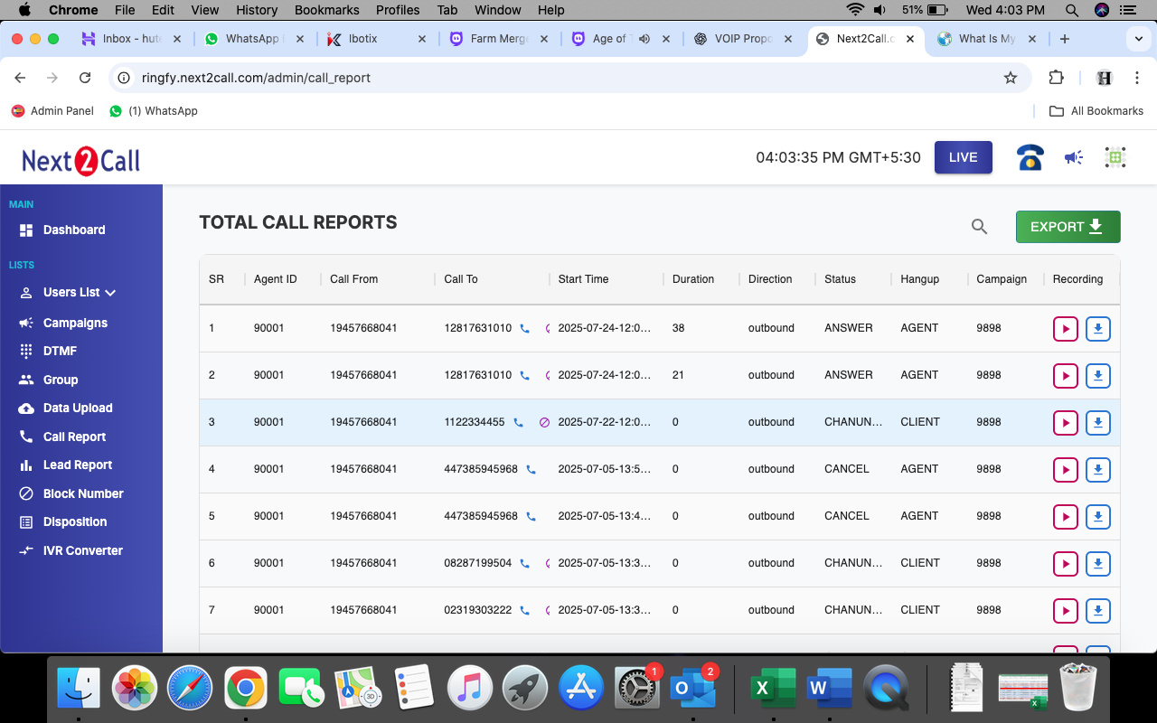
Call Reports:
Comprehensive report of all inbound and outbound calls
Date & time filter
Call duration, status, disposition summary
Export to Excel for analysis

Slide 9
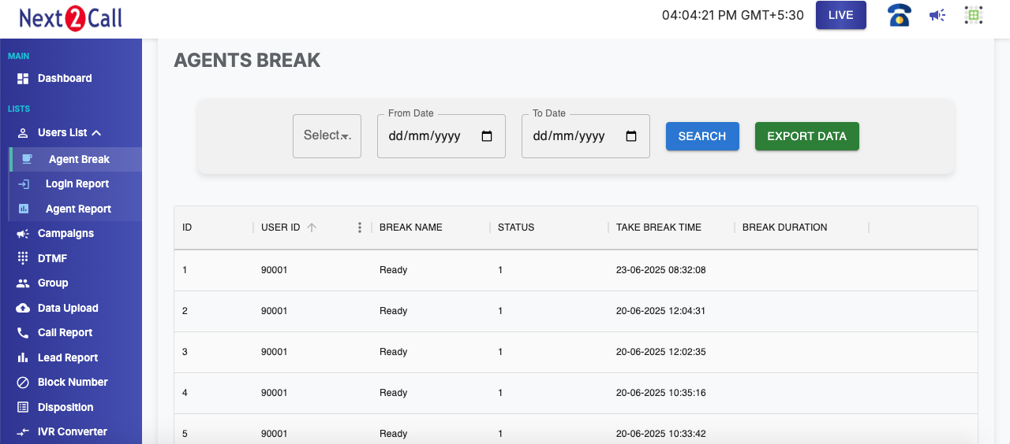
Agent Break Time Report:-
Track agent break status
Break start/end time
Reason for break (tea, lunch, etc.)
Useful for productivity analysis

Slide 10
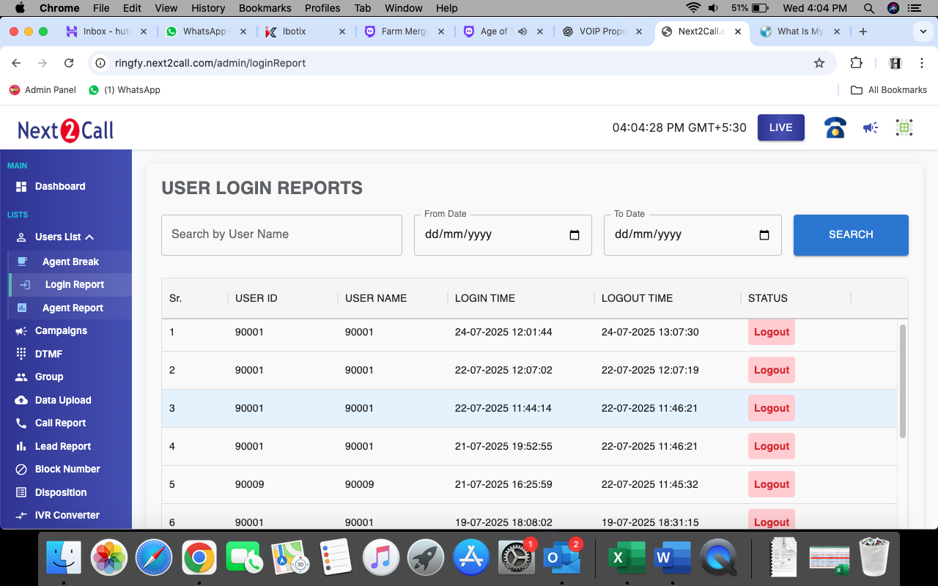
Agent/User Login Reports:-
Detailed history of agent login/Logout time
Real Time status of Agents
Advanced filter option to search agents Login report by Name/User ID

Slide 11
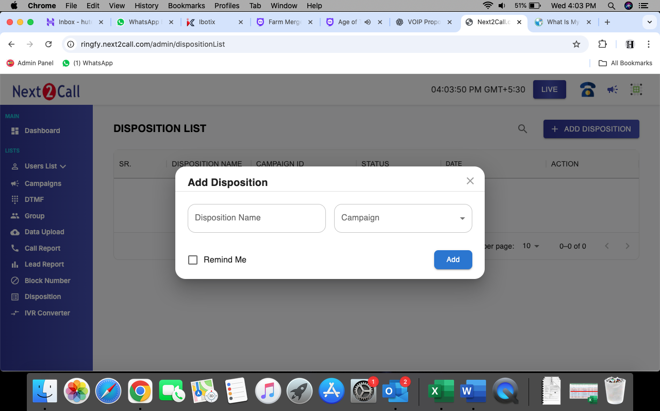
Add and remove disposition:-
Add new call outcomes such as “Interested,” “Callback,” “Not Reachable”
Remove or modify existing dispositions
Disposition-wise agent performance tracking

Slide 12
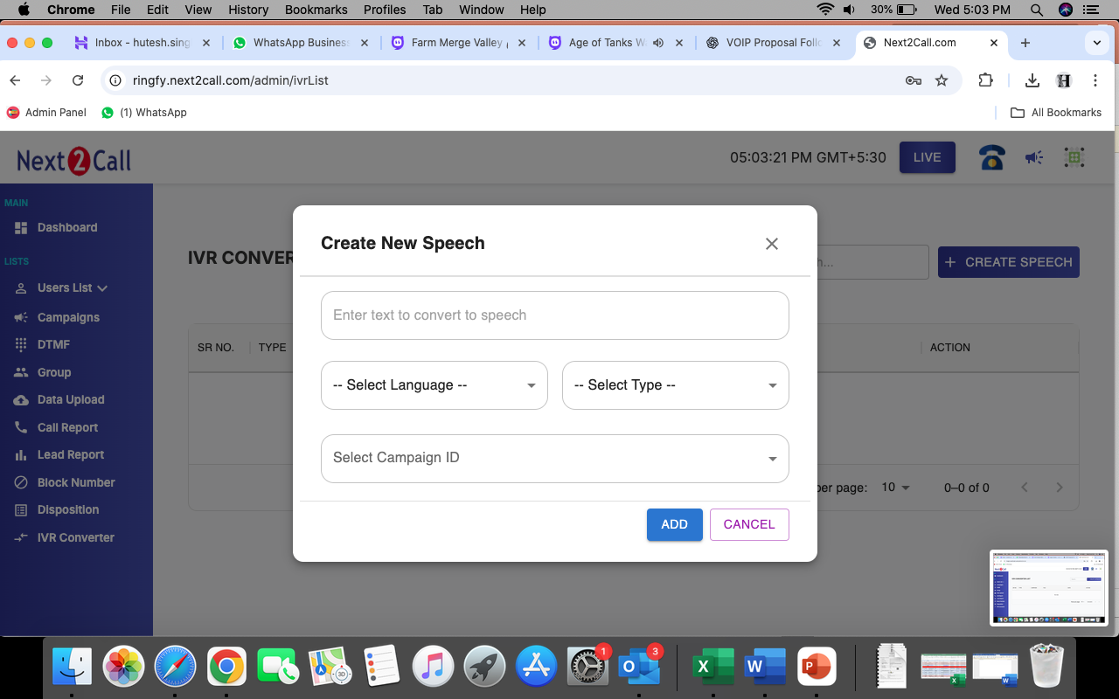
IVR Converter:
Welcome Message IVR Set up a professional greeting for incoming calls during business hours.
After-Office Hour IVR Automatically play a message outside working hours (e.g., "Our office is currently closed...").
Holiday Notification IVR Pre-record and schedule messages for holidays or special non-working days.

Slide 13
Thank You
Thank you for your time and interest in
Next2Call’s Telephony Panel & CRM Solutions
For any queries, demo requests, or custom solutions, feel free to connect with us:
📞 Contact Number: +91-9650866007
📧 Email ID: sales@next2call.com
🌐 Website: www.next2call.com

